Slide 1
Chapter 6. Essential oils and Cosmetic Industries
6.1. Introduction
Essential oils or volatile oils) are natural volatile compounds that large amount of them are produced from plant raw materials or plants organs like flowers, seeds, bud, leaves, fruits, wood, roots, barks and twigs.
They give a distinctive flavour, odour or scent to an aromatic plant. For example, citrus‐derived essential oils included wide group of fruits from genus citrus, are the most well‐known natural EOs and account for the largest spectrum of commercial available natural fragrances and flavours.
EOs are classified into non‐volatile, semi‐volatile, and volatile compounds according to their nature.

Slide 2
The International Organization for Standardization (ISO) defines an essential oil as product manufactured by either water- or vapour distillation, by mechanical processing of citrus peel or by dry distillation.
Almost every part of a plant can produce essential oil, which can be extracted and exploited in various industrial ways.
The essential oils are highly volatile, transparent, and lipid-soluble liquids.
They are soluble in organic solvents such as benzene, toluene, acetone, ethanol, and methanol that have less density compared with water.

Slide 3
Constituents in essential oils
Essential oils are composed of a complex mixture of compounds which give a characteristic odour and flavour to the plants.
The compounds are grouped into main compounds (20–95%), secondary compounds (1–20%), and trace compounds with less than 1% concentration.
The flavour and aroma of plants are influenced by the type and amount of compounds present in the essential oil.
The chemical composition and therefore the quality of essential oils derived from one plant species can vary depending on several factors like the time of harvest, the location of the crop, the part of the plant, as well as the production method.
These factors are also important in ensuring the safe use of essential oils in personal care products.
As they contain compounds with varied chemical structure and effects, skin sensitivity and irritations as well as other symptoms may arise after their application.

Slide 4
In general, the constituents in essential oils are terpenes (monoterpenes and sesquerpenes), aromatic compounds (aldehyde, alcohol, phenol, methoxy derivative, and so on), and terpenoids (isoprenoids).
Compounds and aroma of essential oils can be divided into 2 major groups: terpene hydrocarbons and oxygenated compounds.
Terpene hydrocarbons
The hydrocarbons are the molecule, constituting of H and C atoms arranged in chains. These hydrocarbons may be acyclic, alicyclic (monocyclic, bicyclic, or tricyclic), or aromatic.
Terpenes are the most common class of chemical compounds found in essential oils.
Terpenes are made from isoprene units (several 5 carbon base units, C5), which are the combinations of 2 isoprene units, called a “terpene unit.”

Slide 5
Essential oils consist of mainly monoterpenes (C10) and sesquiterpenes (C15), which are hydrocarbons with the general formula (C5H8)n.
Terpenoids (a terpene containing oxygen) is also found in essential oils
Essential oils mostly contain monoterpenes and sesquiterpenes, which are C10H16(MW 136 amu) and C15H24 (MW 204 amu), respectively. Although sesquiterpenes are larger in molecules, structure and functional properties of sesquiterpenes are similar to the monoterpenes.

Slide 6
Oxygenated compounds
These compounds are the combination of C, H, and O, and there are a variety of compounds found in essential oils.
Oxygenated compounds can be derived from the terpenes, in which they are termed “terpenoids.”
Some oxygenated compounds prevalent in plant essential oils are shown as follows:
- Phenols: thymol, eugenol, carvacrol, chavicol, thymol, and so on.
-Alcohols:
Monoterpene alcohol: borneol, isopulegol, lavanduol, α-terpineol, and so on.
Sesquiterpenes alcohol: elemol, nerolidol, santalol, α-santalol, and so on.

Slide 7
- Aldehydes: citral, myrtenal, cuminaldehyde, citronellal, cinnamaldehyde, benzaldehyde, and so on.
- Ketones: carvone, menthone, pulegone, fenchone, camphor, thujone, verbenone, and so on.
- Esters: bomyl acetate, linalyl acetate, citronellyl acetate, geranyl acetate, and so on.
- Oxides: 1,8-cineole, bisabolone oxide, linalool oxide, sclareol oxide, and so on.
- Lactones: bergaptene, nepetalactone, psoralen, aesculatine, citroptene, and so on.
- Ethers: 1,8-cineole, anethole, elemicin, myristicin, and so on.
Different constituents in essential oils exhibit varying smell or flavor. Also, the perception of individual volatile compounds depends on their threshold

Slide 8
Method for extraction of essential oil from different plants
Essential oils can be extracted from several plants with different parts by various extraction methods.
The manufacturing of essential oils, and the method used for essential oil extraction are normally dependent on botanical material used.
State and form of material is another factor used for consideration. The method of extraction determines the quality of essential oil.
Inappropriate extraction procedures can lead to damage or change of the chemical nature of the essential oil.

Slide 9
Many natural products are thermally unstable and can easily be damaged during thermal extraction. This results in the loss in bioactivity and natural characteristics.
For severe case, discoloration, off-odor/flavor as well as physical change such as the increased viscosity can occur. Those changes in extracted essential oil must be avoided.
The method of extraction used depends on the kind of compounds present in the oil and the location of the oils within the vegetative structure of the plant species.

Slide 10
Distillation
Steam distillation. Steam distillation is the most widely used method for plant essential oil extraction.
The proportion of essential oils extracted by steam distillation is 93% and the remaining 7% can be further extracted by other methods.
Basically, the plant sample is placed in boiling water or heated by steam. The heat applied is the main cause of burst and break down of cell structure of plant material.
As a consequence, the aromatic compounds or essential oils from plant material are released.
The temperature of heating must be enough to break down the plant material and release aromatic compound or essential oil.

Slide 11
A new process design and operation for steam distillation of essential oils to increase oil yield and reduce the loss of polar compounds in wastewater was developed by Masango (2005).
The system consists of a packed bed of the plant materials, which sits above the steam source. Only steam passes through it and the boiling water is not mixed with plant material.
Thus, the process requires the minimum amount of steam in the process and the amount of water in the distillate is reduced.
Also, water soluble compounds are dissolved into the aqueous fraction of the condensate at a lower extent (Masango 2005).

Slide 12
Figure 1–Diagrammatic illustration of steam distillation method.

Slide 13
Hydrodistillation(HD)
HD has become the standard method of essential oil extraction from plant material such as wood or flower, which is often used to isolate nonwater-soluble natural products with high boiling point.
The process involves the complete immersion of plant materials in water, followed by boiling. This method protects the oils extracted to a certain degree since the surrounding water acts as a barrier to prevent it from overheating.
The steam and essential oil vapor are condensed to an aqueous fraction. The advantage of this technique is that the required material can be distilled at a temperature below 100 °C.

Slide 14
Figure 2–Diagrammatic illustration of Hydrodistillation method.

Slide 15
Solvent extraction
Solvent: Conventional solvent extraction has been implemented for fragile or delicate flower materials, which are not tolerant to the heat of steam distillation.
Different solvents including acetone, hexane, petroleum ether, methanol, or ethanol can be used for extraction.
For general practice, the solvent is mixed with the plant material and then heated to extract the essential oil, followed by filtration. Subsequently, the filtrate is concentrated by solvent evaporation.
The concentrate is resin (resinoid), or concrete (a combination of wax, fragrance, and essential oil). From the concentrate, it is then mixed with pure alcohol to extract the oil and distilled at low temperatures.

Slide 16
The alcohol absorbs the fragrance and when the alcohol is evaporated, the aromatic absolute oil is remained. However, this method is a relatively time-consuming process, thus making the oils more expensive than other methods.
Supercritical carbon dioxide
Carbon dioxide (CO2) is the most commonly used supercritical fluid because of its modest critical conditions.
Under high-pressure condition, CO2 turns into liquid, which can be used as a very inert and safe medium to extract the aromatic molecules from raw material.
No solvent residue remains in the final finished product since the liquid CO2 simply reverts to a gas and evaporates under normal atmospheric pressure and temperature.

Slide 17
Application of EO
Essential oils as well as their isolated compounds are widely used in cosmetic products as they offer a variety of benefits.
The main reason for their usage in cosmetics is their pleasant aroma. Fatty acids, fatty oils and surfactants used in the production-process of cosmetic products often exhibit an unpleasant odor.
Effective perfume mixtures are therefore added to these products in order to mask it.
If such a product is not explicitly labelled as “fragrance-free”, “contains no perfume” or “scented-free” it can be assumed that it contains fragrance chemicals

Slide 18
Essential oils are also known to exhibit antimicrobial activity against a wide range of bacteria and fungi.
The antimicrobial activity of essential oils is due to their solubility in the phospholipid bilayer of cell membranes.
Thus, EOs can be applied in various cases including pharmaceutical and health industries (as antiseptic, antibiotic, antiparasitic and anti‐inflammatory agents), chemical industries, food sectors (as preserving and flavourings agents), the cosmetics and perfume industries (as fragrances, antibacterials and aromatherapeutic agents), and also, agriculture pathogenic agents such as phytopesticides, agricultural pests and weeds or bioinsecticide and biofungicide.
Their applications have been increasing due to wide requirements for pure natural ingredients, which caused these materials be inseparable part of our life.

Slide 19
Some main components of essential oils. 6.2. Eugenol and geraniol
Eugenol is a naturally occurring aromatic compound derived primarily from cloves, and used as a flavoring agent.
So,the primary uses of eugenol are as a fragrance and flavor.
It is also used as a pesticide and has several applications.
It is an allyl chain-substituted guaiacol that is slightly soluble in water.
Eugenol first isolated from cloves in 1826, thus, clove oil remains the primary commercial source of eugenol.
Eugenol can be synthesized by various methods, but steam distillation of clove oil is the main process by which eugenol is isolated.

Slide 20
Hydrodistillation is the traditional method used, and some eugenol is extracted using a synthetic solvent, such as dichlormethane.
Supercritical extraction with carbon dioxide increases the oil yield from clove flowers, but lowers the eugenol content.

Slide 21
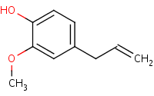
Chemical and Physical Properties of Eugenol
The molecular structure of eugenol
Molecular Formula: C10H12O2
It is Liquid at room temperature and has Colorless to pale yellow color.
Eugenol is insoluble in water; Soluble in ether, most fixed oils.
Miscible in alcohol, chloroform, ether, oils
Eugenol is recognized as a skin and eye irritant

Slide 22
Geraniol
Geraniol is a commercially important terpene alcohol occurring in the essential oils of several aromatic plants.
It is one of the most important molecules in the flavour and fragrance industries and is a common ingredient in consumer products produced by these industries.
In addition to its pleasant odour, geraniol is known to exhibit insecticidal and nauseating properties and used as a natural pest control agent exhibiting low toxicity.
Geraniol has been suggested to represent a new class of chemoprevention agents for cancer. Other biological activities such as antimicrobial, antioxidant, anti-inflammatory and some vascular effects

Slide 23
Geraniol (3,7-dimethylocta-trans-2,6-dien-1-ol) is an acyclic monoterpene alcohol with the chemical formula C10H18O.
The product referred to as “geraniol” is a mixture of the two cis-trans isomers properly named geraniol (trans) and nerol (cis).
Geraniol was isolated from Palmarosa oil while nerol was obtained from the oil of neroli.
Geraniol appears as a clear to pale-yellow oil which is insoluble in water, but soluble in most organic solvents.
It is emitted from the flowers of many species and it is present in vegetative tissues of many herbs and often co-exists with geranial and neral, which are the oxidation products of geraniol

Slide 24
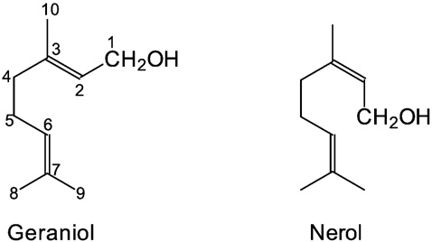
Chemical structure of geraniol and nerol

Slide 25
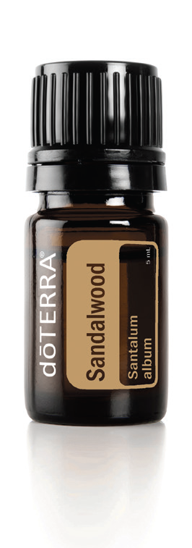
6.3. Sandalwood oil, eucalyptus, and rose oil
A) Sandalwood oil
Plant Part: Wood
Extraction Method: Steam distillation
Main Chemical Components: α-santalol, ß-santalol

Slide 26
Sandalwood tree (Santalum album) is one of the plants that contains essential oils in its stems and roots.
Most oil content in the sandalwood tree is located on the terrace which is part of the stem or roots that have a yellow to light brown color and is very fragrant.
Sandalwood is being used worldwide mainly for the high valued fine fragrance, cosmetics and aromatherapy.
Sandalwood oil has a high economic value.
unlike other aromatic woods, can retain their fragrance for decades.
Both the wood and oil have been highly valued for centuries and Sandalwood has a documented history of many applications.

Slide 27
Sandalwood oil was traditionally used as an incense in religious ceremonies and for enhancing meditation, and the Egyptians used sandalwood for preserving.
It is very beneficial to the skin; it can help reduce the appearance of skin imperfections and it promotes a healthy, smooth complexion.
Sandalwood has a sweet, woody aroma that is frequently used in meditation for its grounding effects.
Phytochemical analysis of different parts of Indian Sandalwood i.e., fruit, seed, bark, leaf, heartwood and root revealed the presence of fatty acids -saturated and unsaturated, amino acids -essential and non-essential,minerals,sesquiterpene alcohols, sesquiterpene and other terpenoides, flavonoids, tannins, esters, aldehydes, squalene and vitam.
It has some specific phyto constituents such as ximenynic acid (fatty acid), α-santalol and β-santalol (sesquiterpene alcohols).

Slide 28
Eucalyptus oil
Eucalyptus oil is the generic name for distilled oil from the leaf of Eucalyptus, a genus of the plant family Myrtaceae native to Australia and cultivated worldwide.
Eucalyptus oil has a history of wide application, as a pharmaceutical, antiseptic, repellent, flavouring, fragrance and industrial uses.
The leaves of selected Eucalyptus species are steam distilled to extract eucalyptus oil.
Essential oils of various eucalyptus species are used in the pharmaceutical, toiletries, cosmetics, and food industries.
These broad applications are due to the antiseptic, anti hyperglycemic, anti-inflammatory, flavouring, and antioxidant properties of the molecules present in the oil .

Slide 29
Eucalyptus oil has a bactericidal effect and is widely used in pharmaceutical products. It can also be used as a flavoring agent for food additives, cough syrup, gum, gargle, toothpaste, air cleaner, etc.
The strong antimicrobial activity may be directly associated with their major compounds in the oil (such as 1,8-cineole and 𝛼-pinene) or with the synergy between the major and minor constituents
The food industry has applied eucalyptus essential oils mainly as flavoring agents.
But , the use of essential oils as preservatives in food has been limited. Because the required concentration against microorganisms is affected by the interactions of the oil compounds with the food matrix components, higher concentrations are needed to achieve sufficient activity.
This negatively impacts the organoleptic properties of the final product .
To overcome this problem, a promising alternative is the use of a combination of mild temperature treatment with essential oils .
A mild thermal treatment, in fact, enhances the antimicrobial efficacy of the essential oil influencing the vapour pressure of the molecules.

Slide 30
rose oil
Plant Part: Flower
Extraction Method: Steam distillation
Aromatic Description: Floral, sweet, earthy
Main Chemical Composition: Citronellol, Geraniol, Nonadecane, Nerol.
Use
Provides a comforting and elevating aroma
Helps balance moisture levels in the skin and reduce the appearance of skin imperfections
Promotes an even skin quality and healthy-looking skin texture

Slide 31
Rose oil is the essential oil extracted from the petals of various types of rose. Rose ottos are extracted through steam distillation, while rose absolutes are obtained through solvent extraction, the absolute being used more commonly in perfumery.
Even with their high price and the advent of organic synthesis, rose oils are still perhaps the most widely used essential oil in perfumery.
Two major species of rose are cultivated for the production of rose oil:
Rosa damascena, the damask rose, which is widely grown in Bulgaria, Syria, Turkey, Russia, Pakistan, India, Uzbekistan, Iran and China
Rosa centifolia, the cabbage rose, which is more commonly grown in Morocco, France and Egypt.

Slide 32
The most common chemical compounds present in rose oil are:
citronellol, geraniol, nerol, linalool, phenyl ethyl alcohol, farnesol, stearoptene, α-pinene, β-pinene, α-terpinene, limonene, p-cymene, camphene, β caryophyllene, neral, citronellyl acetate, geranyl acetate, neryl acetate, eugenol, methyl eugenol, rose oxide, α-damascenone, β damascenone, benzaldehyde, benzyl alcohol, rhodinyl acetate and phenyl ethyl formate.

Slide 33
Extraction method of rose oil
Due to the labor-intensive production process and the low content of oil in the rose flower, rose oil commands a very high price.
Harvesting of flowers is done by hand in the morning before sunrise, and the material is distilled the same day.
There are three main methods of extracting the oil from the plant material:
Steam distillation, which produces an essential oil called rose otto or attar of roses.
Solvent extraction, which results in an absolute called rose absolute.
Supercritical carbon dioxide extraction, yielding a concrete that may be marketed as a concrete, absolute or CO₂ extract.

Slide 34
6.4. 2-phenyl ethyl alcohol
Phenethyl alcohol, or 2-phenylethanol, is the organic compound that consists of a phenethyl group (C₆H₅CH₂CH₂) attached to OH.
It is a colourless liquid that is slightly soluble in water, but miscible with most organic solvents.
It occurs widely in nature, being found in a variety of essential oils. It has a pleasant floral odor.

Slide 35
Synthesis of 2-phenyl ethyl alcohol
Phenethyl alcohol is prepared commercially via two routes. Most common is the Friedel-Crafts reaction between benzene and ethylene oxide in the presence of aluminium trichloride.
C₆H₆ + CH₂CH₂O + AlCl₃ → C₆H₅CH₂CH₂OAlCl₂ + HCl
The reaction affords the aluminium alkoxide that is subsequently hydrolyzed to the desired product.
The main side product is diphenylethane, which can be avoided by use of excess benzene.
Hydrogenation of styrene oxide also affords phenethyl alcohol.
Phenethyl alcohol can also be prepared by the reaction between phenylmagnesium bromide and ethylene oxide:
C₆H₅MgBr + CH₂CH₂O → C₆H₅CH₂CH₂OMgBr
C₆H₅CH₂CH₂OMgBr + H⁺ → C₆H₅CH₂CH₂OH

Slide 36
Occurrence and uses of 2-phenyl ethyl alcohol
Phenethyl alcohol is found in extract of rose, carnation, hyacinth, Aleppo pine, orange blossom, ylang-ylang, geranium, neroli, and champaca.
It is also an autoantibiotic produced by the fungus Candida albicans.^{[6]}
It is therefore a common ingredient in flavors and perfumery, particularly when the odor of rose is desired.
It is used as an additive in cigarettes.
It is also used as a preservative in soaps due to its stability in basic conditions.
It is of interest due to its antimicrobial properties.

Slide 37
6.5. Jasmone, civetone, and muscone
Jasmone is an organic compound, which is a volatile portion of the oil from jasmine flowers.
It is a colorless to pale yellow liquid.
Jasmone can exist in two isomeric forms with differing geometry around the pentenyl double bond, cis-jasmone and trans-jasmone.
The natural extract contains only the cis form, while synthetic material is often a mixture of both, with the cis form predominating.
Both forms have similar odors and chemical properties.
Jasmone is produced by some plants by the metabolism of jasmonic acid, via a decarboxylation.

Slide 38
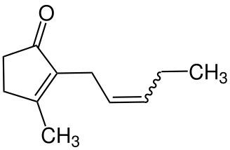
It can act as either an attractant or a repellent for various insects.
Commercially jasmone is used primarily in perfumes and cosmetics.
Its structure was deduced by Lavoslav Ružička.
Structure of jasmone

Slide 39
Civetone
Civetone is a macrocyclic ketone and the main odorous constituent of civet oil.
It has a strong musky odor that becomes pleasant at extreme dilutions.
Today, civetone can be synthesized from precursor chemicals found in palm oil.
Chemical formula: C17H₃₀O
Civetone is soluble in oils, in ethanol and slightly soluble in water.
Civetone is used as a perfume fixative and flavor.

Slide 40
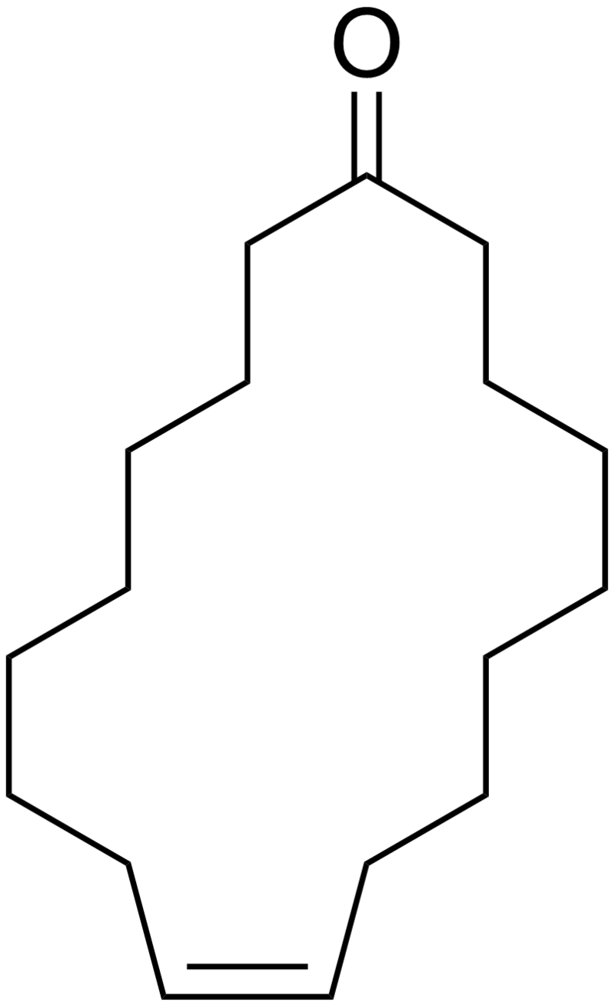
Structure of Civetone

Slide 41
Muscone
Muscone is an organic compound that is the primary contributor to the odor of musk.
It consists of a 15-membered ring ketone with one methyl substituent in the 3-position.
It is very slightly soluble in water and miscible with alcohol.
It has been used in perfumery and medicine for thousands of years.
Since obtaining natural musk requires killing the endangered animal, nearly all muscone used in perfumery today is synthetic.
It has the characteristic smell of being "musky".

Slide 42
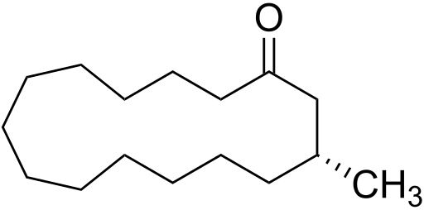
The chemical structure of muscone was first elucidated by Leopold Ružička
Structure of muscone

Slide 43
End of chapter-6

